Slide 1

CN Lab - 18CSL57
BMSIT&M – Dept. Of I.S.E
‘TRANSFROM HERE’
SOCKET PROGRAM- Udp

Slide 2
SOCKETS & DATAGRAMS :
Sockets allow communication between two different processes on the same or different machines. To be more precise, it's a way to talk to other computers using standard Unix file descriptors.
In computer operating systems, a datagram socket is a type of interprocess communication sockets or network sockets which provides a connectionless point for sending or receiving data packets.
Each packet sent or received on a datagram socket is individually addressed and routed. Order and reliability are not guaranteed with datagram sockets, so multiple packets sent from one machine or process to another may arrive in any order or might not arrive at all.
The sending of UDP (USER DATAGRAM PROTOCOL) broadcasts on a network are always enabled on a datagram socket.

Slide 3
AIM: Write a program on datagram socket for client/server to display the messages on client side, typed at the server side
Basic Concept: A client program creates a socket on its end of the communication and attempts to connect that socket to a server. When the connection is made, the server creates a socket object on its end of the communication. The client and the server can now communicate by writing to and reading from the socket.

Slide 4
Source Code – UDPClient.java
import java.io.*;
import java.net.*;
class UDPClient
{
public static void main(String args[]) throws Exception
{
BufferedReader inFromUser = new BufferedReader(new InputStreamReader(System.in));
DatagramSocket clientSocket = new DatagramSocket();
InetAddress IPAddress = InetAddress.getByName("localhost");
byte[] sendData = new byte[1024];
byte[] receiveData = new byte[1024];
System.out.println("Enter 'START' to connect to Server");
String sentence = inFromUser.readLine();
sendData = sentence.getBytes();
DatagramPacket sendPacket = new DatagramPacket(sendData, sendData.length, IPAddress, 9876);
clientSocket.send(sendPacket);
DatagramPacket receivePacket = new DatagramPacket(receiveData, receiveData.length);
clientSocket.receive(receivePacket);
String modifiedSentence = new String(receivePacket.getData());
System.out.println("Message received from Server: " + modifiedSentence);
clientSocket.close();
}
}

Slide 5
Source Code – UDPServer.java
import java.io.*; import java.net.*; import java.util.Scanner;
class UDPServer
{
public static void main(String args[]) throws Exception
{
DatagramSocket serverSocket = new DatagramSocket(9876);
System.out.println("Server Started on Port 9876");
byte[] receiveData = new byte[1024];
byte[] sendData = new byte[1024];
while(true)
{
DatagramPacket receivePacket = new DatagramPacket(receiveData, receiveData.length);
serverSocket.receive(receivePacket);
receivePacket.getData();
InetAddress IPAddress = receivePacket.getAddress();
int port = receivePacket.getPort();
System.out.println("Client Connected");
Scanner input = new Scanner(System.in);
System.out.println("Enter the message to be sent: ");
String message = input.nextLine();
sendData = message.getBytes();
DatagramPacket sendPacket = new DatagramPacket(sendData, sendData.length, IPAddress, port);
serverSocket.send(sendPacket);
System.exit(0);
} } }

Slide 6
Execution Steps:
Open 2 terminal of command prompt ,one to compile UDPClient.java and one to compile UDPServer.java.
Enter the message at server terminal
Message displayed at client terminal

Slide 7
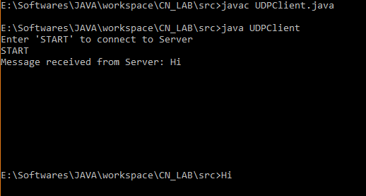
Output: UDPClient Terminal

Slide 8
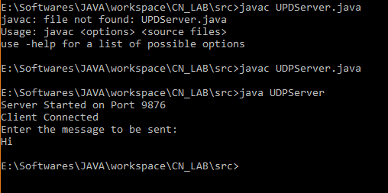
Output: UDPServer Terminal

Slide 9
Submitted By:
AKSHAT GUPTA
1BY15IS005
THANK YOU.

